Slide 1

Introduction to JavaScript: Basics to Intermediate Concepts
A Guide for Developers and Programming Students
Presented by: AI Presentation Designer | Date: Autumn 2024

Slide 2
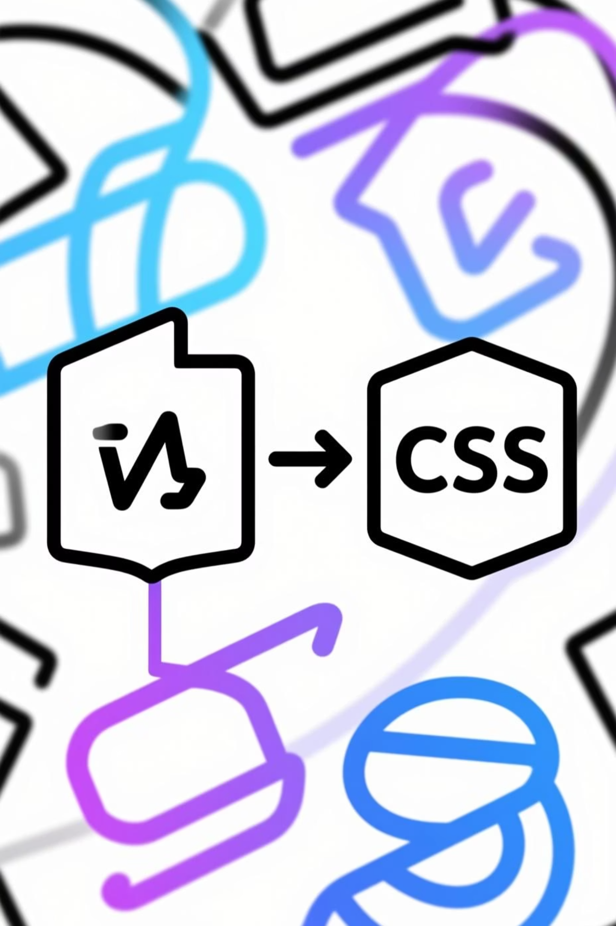
What is JavaScript?
The Definition
1
JavaScript is a high-level, interpreted scripting language that powers the dynamic behaviour of most web pages. It is one of the core technologies of the World Wide Web.
Core Purpose
2
It primarily enables interactive and dynamic content on the client side (in the browser), enhancing the user experience beyond static HTML and CSS.
Where is it Used?
3
Frontend Web Development (Browser)
Backend Development (Node.js)
Mobile and Desktop Applications

Slide 3
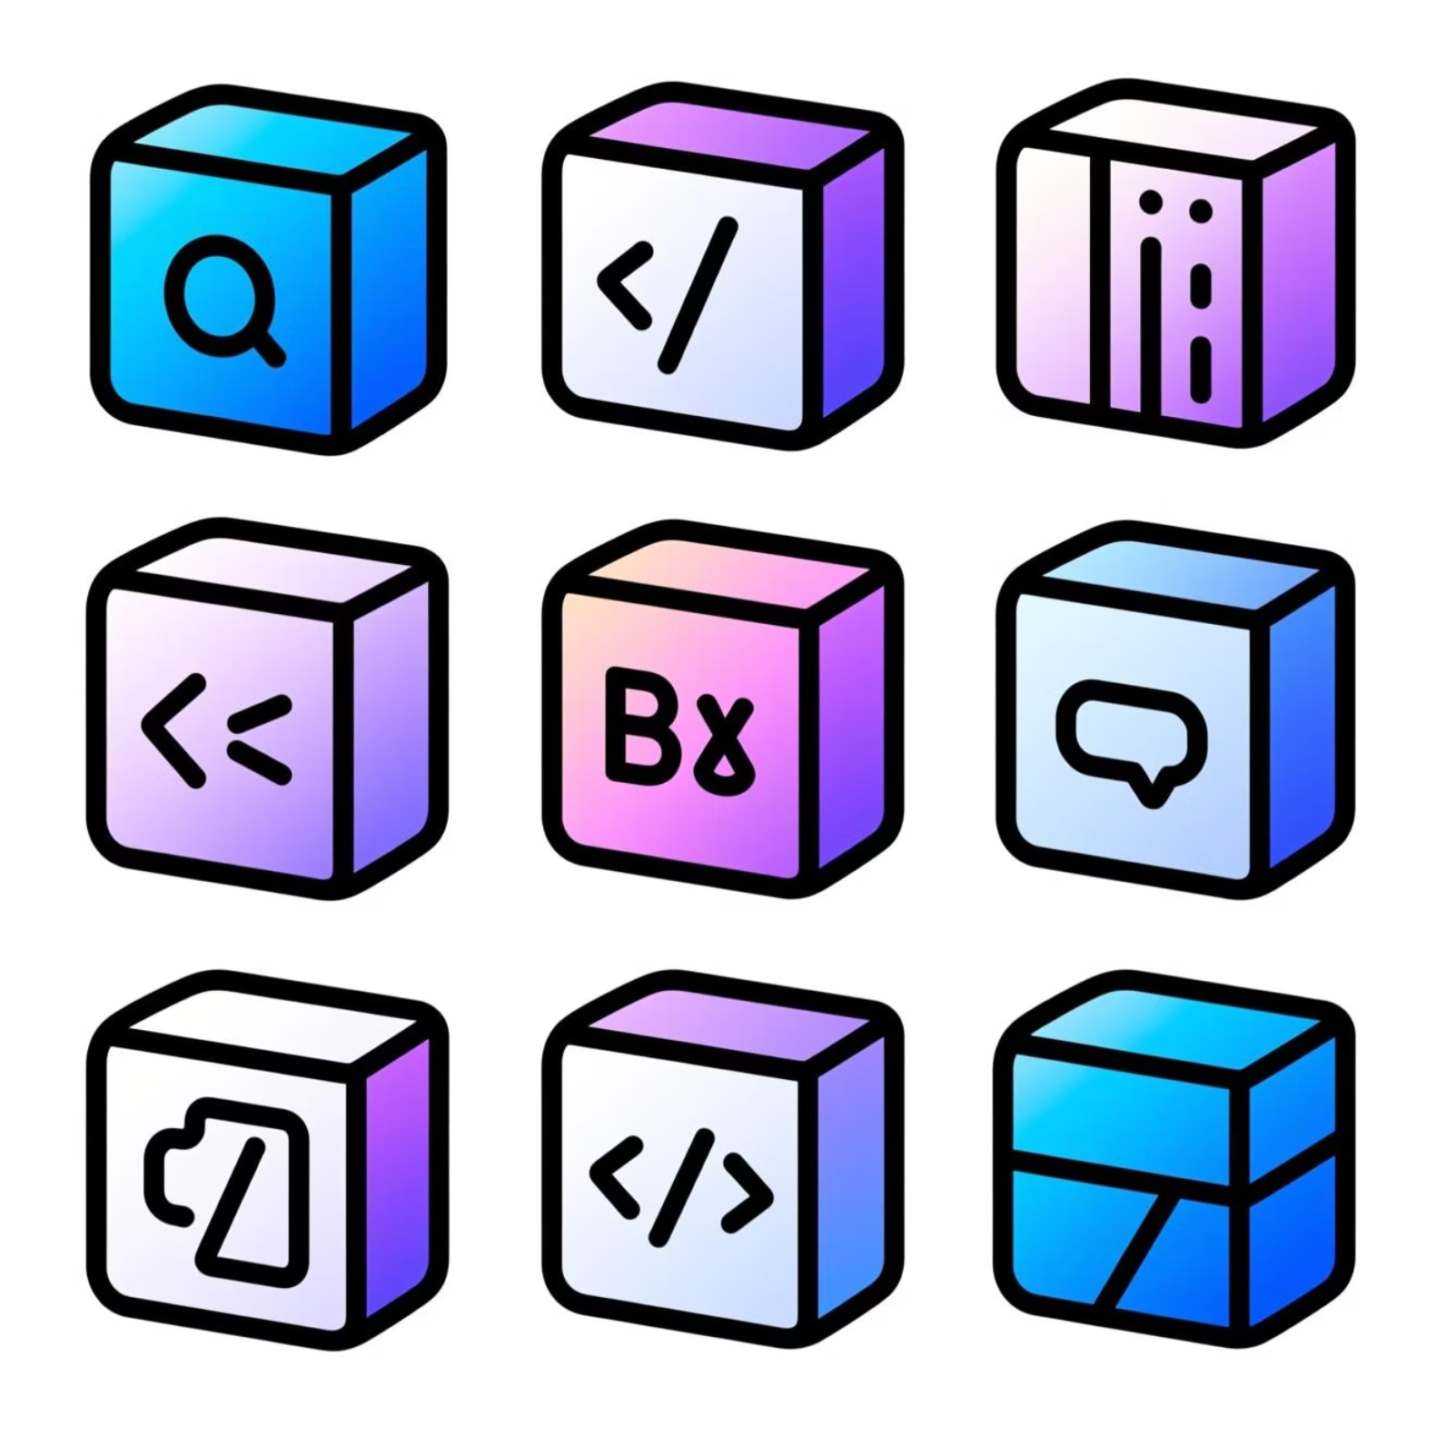
Syntax, Variables, and Data Types
Variable Declaration
Primitive Data Types
var: Older, function-scoped. Avoid in modern code.
Number
let: Block-scoped, can be reassigned (mutable).
Integers and floating-point values.
const: Block-scoped, cannot be reassigned (immutable).
String
Text data, enclosed in quotes.
let count = 10;const API_URL = "example.com";
Boolean
Logical values: true or false.
Complex Data Structures
Arrays and Objects allow grouping of related data:
// Arraylet colours = ['red', 'blue', 'green'];// Objectlet user = {name: 'Alex', age: 30};

Slide 4

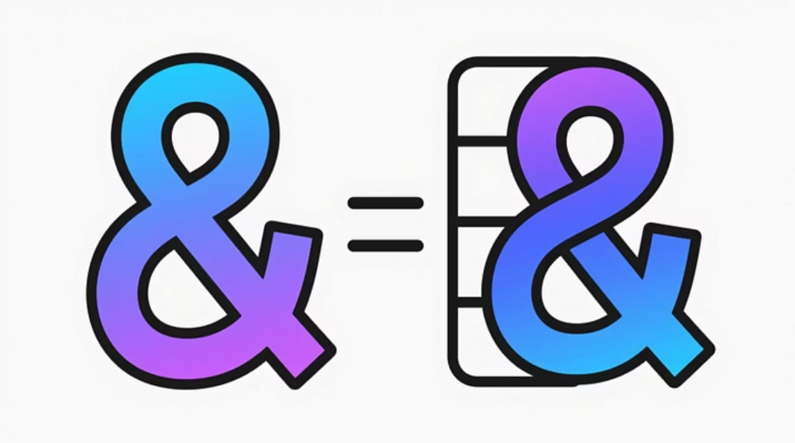
Operators and Expressions: The Logic Tools
Operators allow us to perform operations on values and variables to produce results.
Arithmetic & Assignment
Comparison Operators
Logical Operators
Perform mathematical calculations (+ - * /) and assign values (=, +=).
Compare two values and return a Boolean result (true/false).
Combine or modify Boolean expressions (AND &&, OR ||, NOT !).
let x = 5 + 3; // x is 8x *= 2; // x is 16
2 == '2'; // true (loose equality)2 === '2'; // false (strict equality)5 > 3; // true
let isAdmin = true;let canAccess = isAdmin && (age >= 18);

Slide 5




Functions: Packaging Code for Reusability
Functions are blocks of code designed to perform a particular task. They are essential for writing clean, modular, and maintainable code.
Declaration
Using the function keyword to define the function and its name.
Parameters
Placeholders for values that can be passed into the function when it is called.
Return Values
The return statement sends a value back to the caller.
Example: Calculating Area
function calculateArea(length, width) { return length * width;}let result = calculateArea(10, 5); // result is 50

Slide 6

Control Flow: Conditionals and Loops
Conditional Statements
Loops (Iteration)
Used to execute different actions based on different conditions being true or false.
Used to repeatedly execute a block of code until a condition is met.
If-Else
For / While
Executes one block if a condition is met, and another otherwise.
Standard looping mechanisms for known/unknown iteration counts.
Switch
ForEach
Evaluates an expression against multiple potential cases.
A method for iterating over elements in an Array.
let score = 90;if (score > 80) { // Pass} else { // Fail}
const nums = [1, 2, 3];nums.forEach(n => console.log(n));

Slide 7
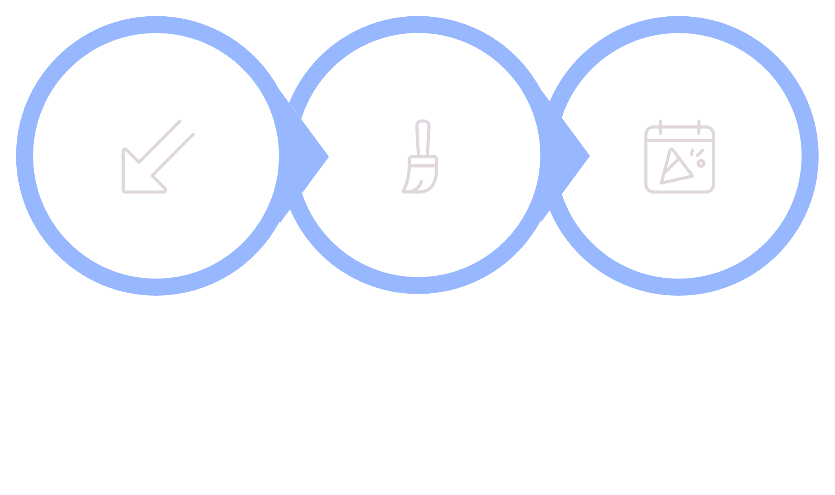

DOM Manipulation Basics
The Document Object Model (DOM) is a programming interface for web documents. It represents the page so that programs can change the document structure, style, and content.
Handle Events
Select
Modify
Key Methods and Snippets
1
2
3
Selecting Elements
Changing Content
Adding Event Listeners
document.querySelector('#idName') or document.getElementById('id')
element.innerHTML = 'New Text'
element.addEventListener('click', handler)

Slide 8
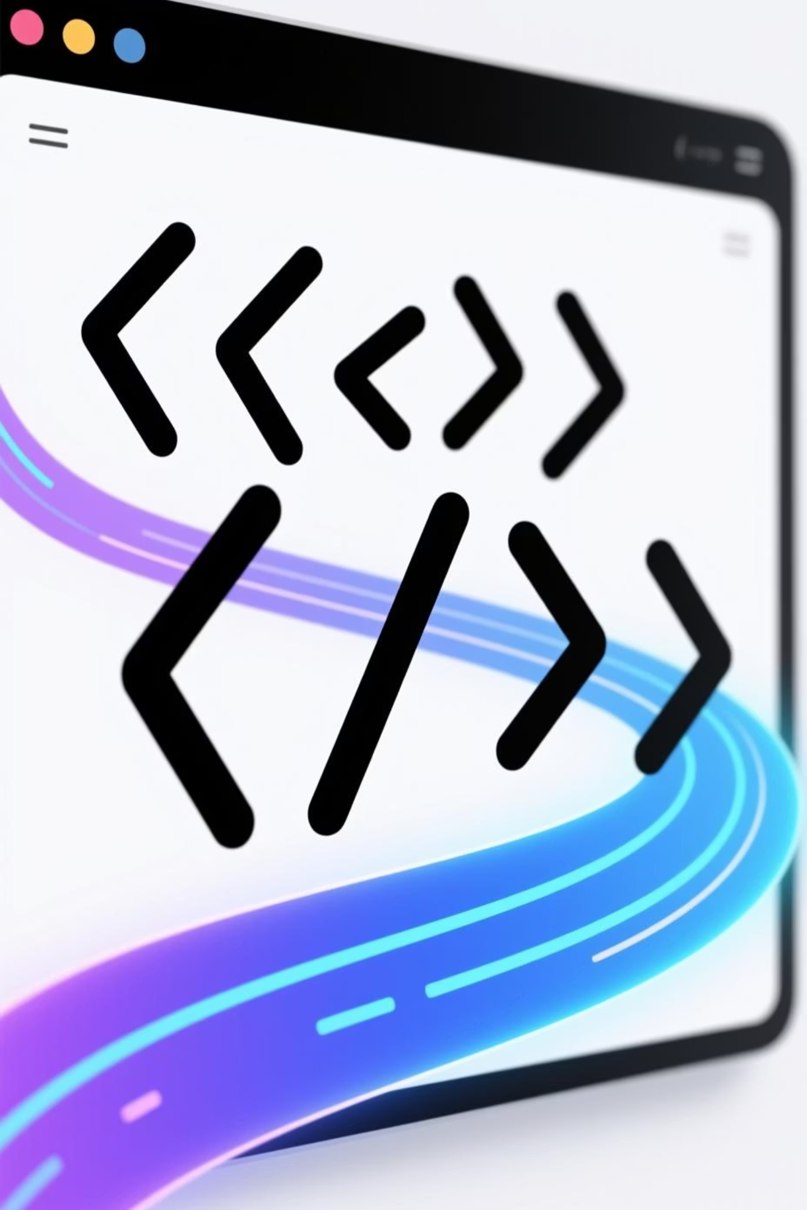
Thank You!
Continue experimenting with the concepts of control flow, functions, and the DOM to build your first interactive projects.

